Slide 1
DATA 300
Topic 6: Tree-based methods

Slide 2
Agenda
Decision trees
Overview
Regression trees
Tree pruning
Classification trees
Tree-based methods
Bagging
Random Forest
Boosting

Slide 3
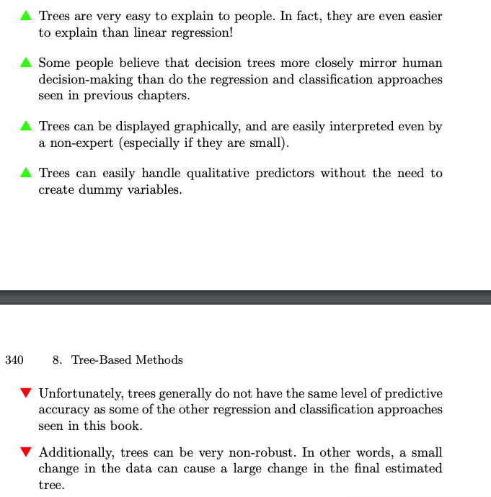
Pros and cons of decision trees
All tree-based methods are trying to tackle these disadvantages.

Slide 4
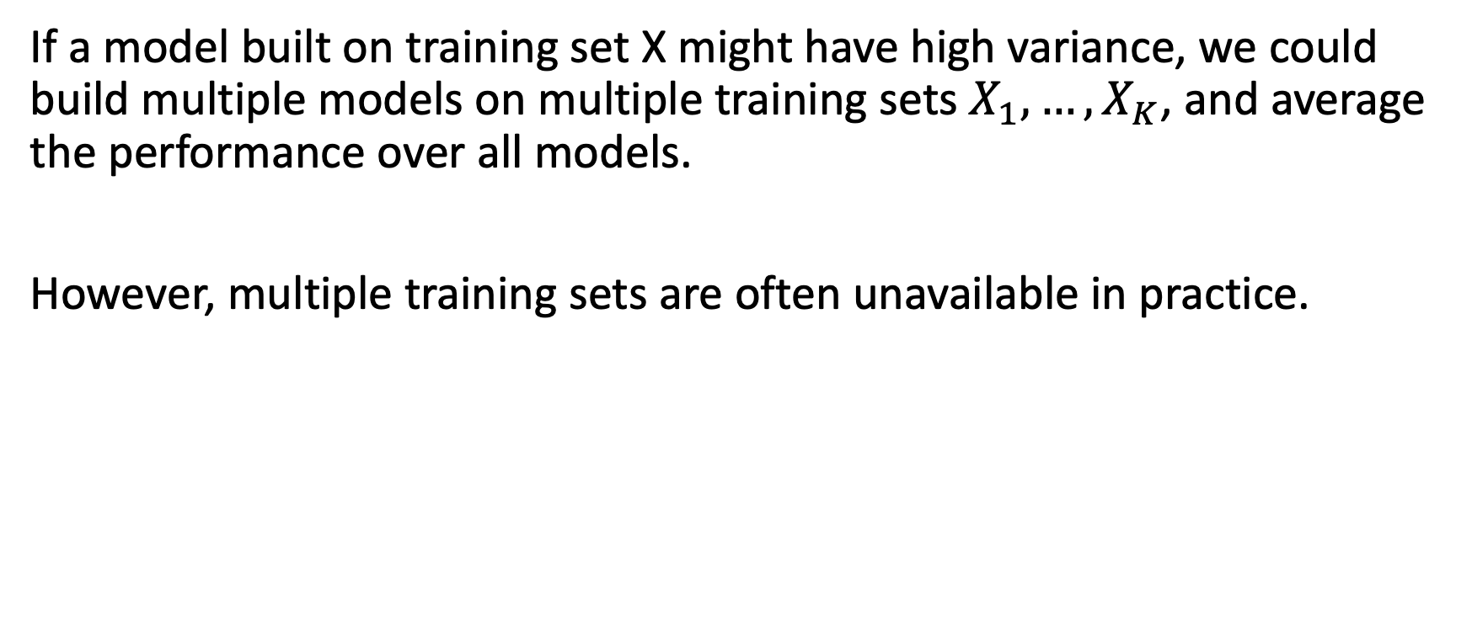
General rule in reducing variance
If a model built on training set X might have high variance, we could build multiple models on multiple training sets $X_{1},…,X_{K}$, and average the performance over all models.
However, multiple training sets are often unavailable in practice.

Slide 5
Recall bootstrapping as a sampling methods
The Bootstrapping method refers to the procedure of repeatedly sampling (with replacement) from the dataset.
As a result, we could obtain multiple datasets from the initial dataset, and would be able to measure variation among datasets.

Slide 6

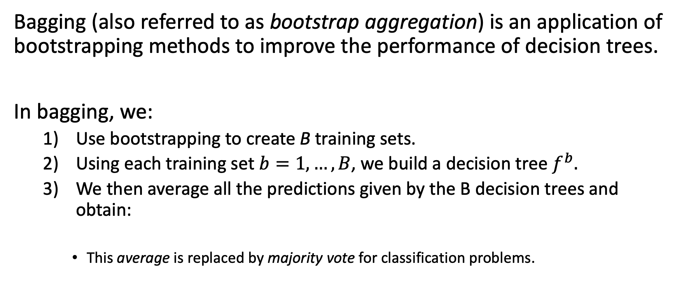
Bagging
Bagging (also referred to as bootstrap aggregation) is an application of bootstrapping methods to improve the performance of decision trees.
In bagging, we:
Use bootstrapping to create B training sets.
Using each training set $b=1,…, B$, we build a decision tree $f^{b}.$
We then average all the predictions given by the B decision trees and obtain:
This average is replaced by majority vote for classification problems.

Slide 7
Out-of-bag error
Unlike most methods where we use cross-validation to estimate the test error of a model, the test error could be estimated by the out-of-bag error in bagging.
Out-of-bag observation: mathematically, every observation is, on average, only included in two-thirds of the B bootstrapped training sets. In other words, it is out-of-bag for the remaining one-third.

Slide 8
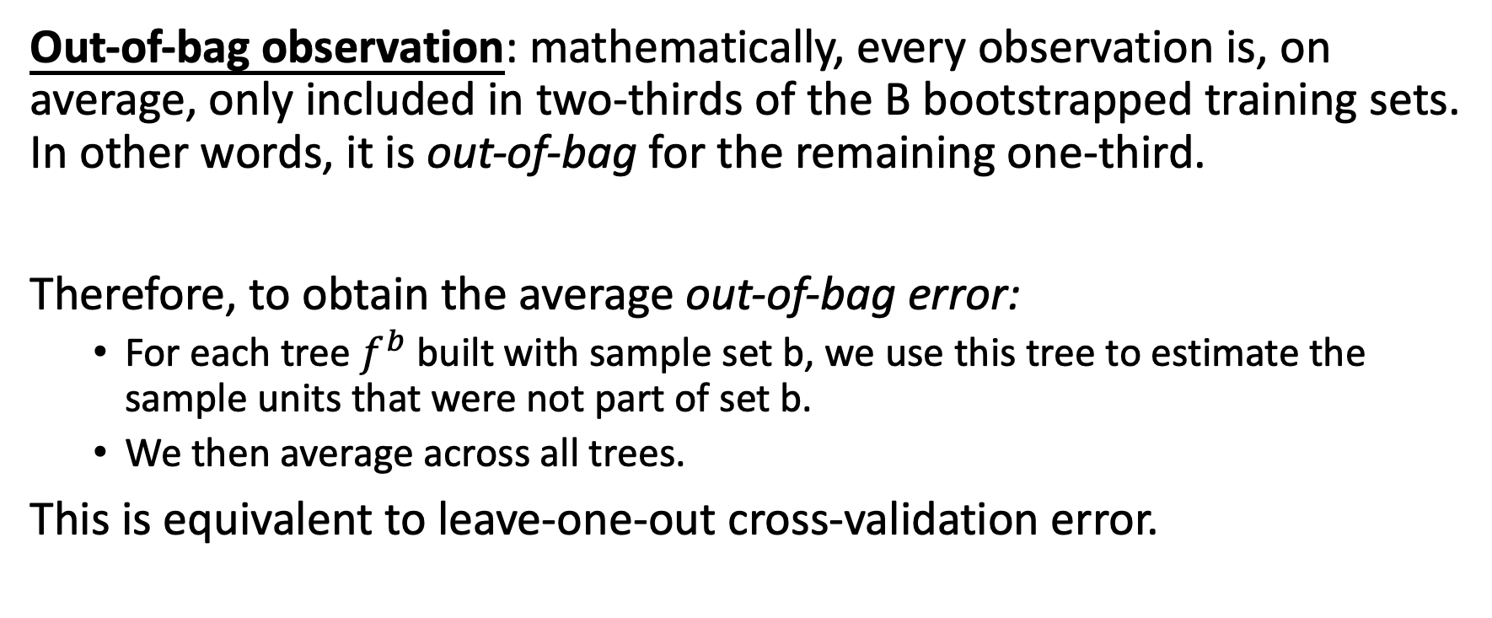
Out-of-bag error
Out-of-bag observation: mathematically, every observation is, on average, only included in two-thirds of the B bootstrapped training sets. In other words, it is out-of-bag for the remaining one-third.
Therefore, to obtain the average out-of-bag error:
For each tree $f^{b}$ built with sample set b, we use this tree to estimate the sample units that were not part of set b.
We then average across all trees.
This is equivalent to leave-one-out cross-validation error.

Slide 9
Variable Importance Measures
Because bagging is an average over multiple decision trees, it is nearly impossible to interpret the results. Bagging reduces the variance of decision trees at the expensive of interpretability.

Slide 10
Variable Importance Measures
Because bagging is an average over multiple decision trees, it is nearly impossible to interpret the results. Bagging reduces the variance of decision trees at the expensive of interpretability.
Therefore, to measure the importance of different variables, we have to track the average impact of each variable over B trees. Specifically, for each predictor, we track the total decreased RSS/GINI index/entropy.
Variable importance are then sorted by their contribution to RSS/Gini/entropy.

Slide 11
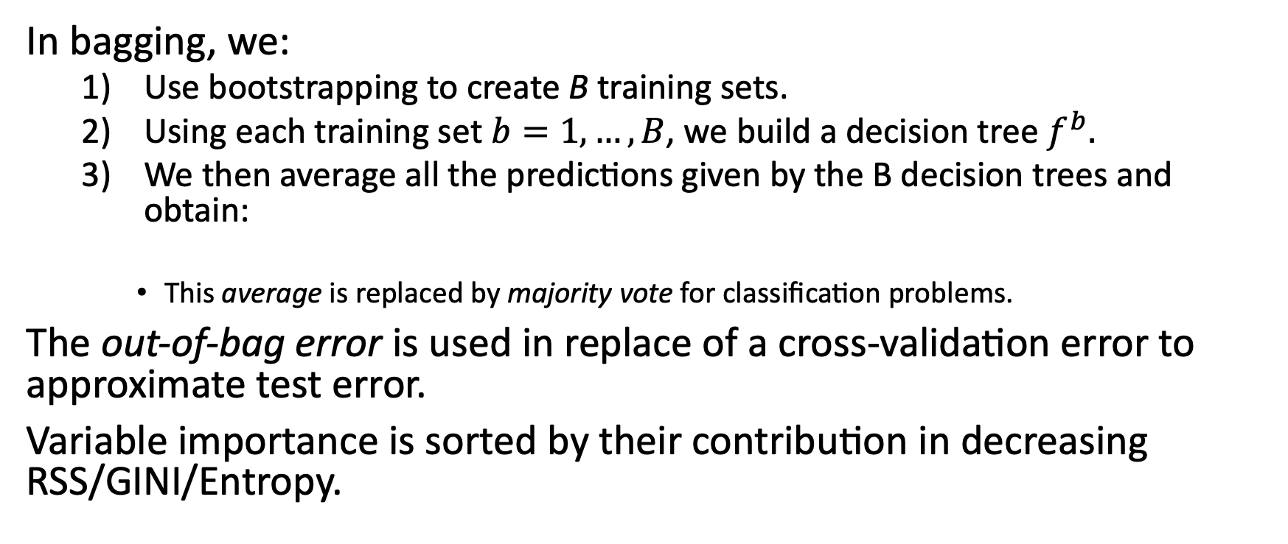
Summary of Bagging
In bagging, we:
Use bootstrapping to create B training sets.
Using each training set $b=1,…, B$, we build a decision tree $f^{b}.$
We then average all the predictions given by the B decision trees and obtain:
This average is replaced by majority vote for classification problems.
The out-of-bag error is used in replace of a cross-validation error to approximate test error.
Variable importance is sorted by their contribution in decreasing RSS/GINI/Entropy.

Slide 12
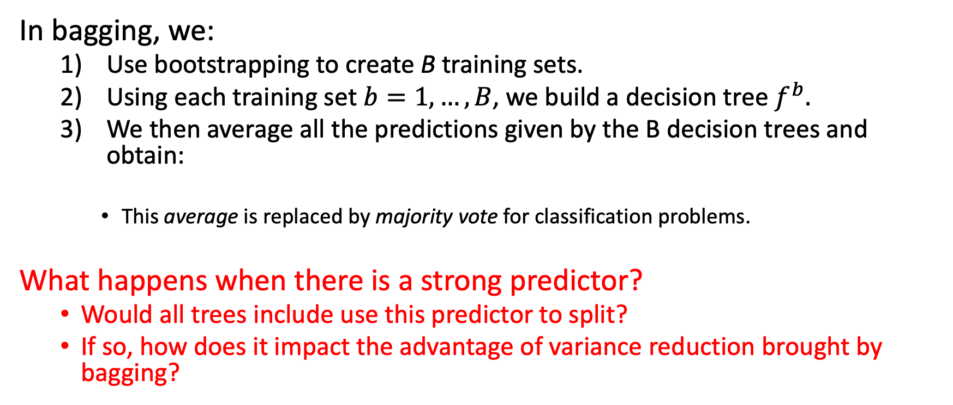
Summary of Bagging
In bagging, we:
Use bootstrapping to create B training sets.
Using each training set $b=1,…, B$, we build a decision tree $f^{b}.$
We then average all the predictions given by the B decision trees and obtain:
This average is replaced by majority vote for classification problems.
What happens when there is a strong predictor?
Would all trees include use this predictor to split?
If so, how does it impact the advantage of variance reduction brought by bagging?

Slide 13
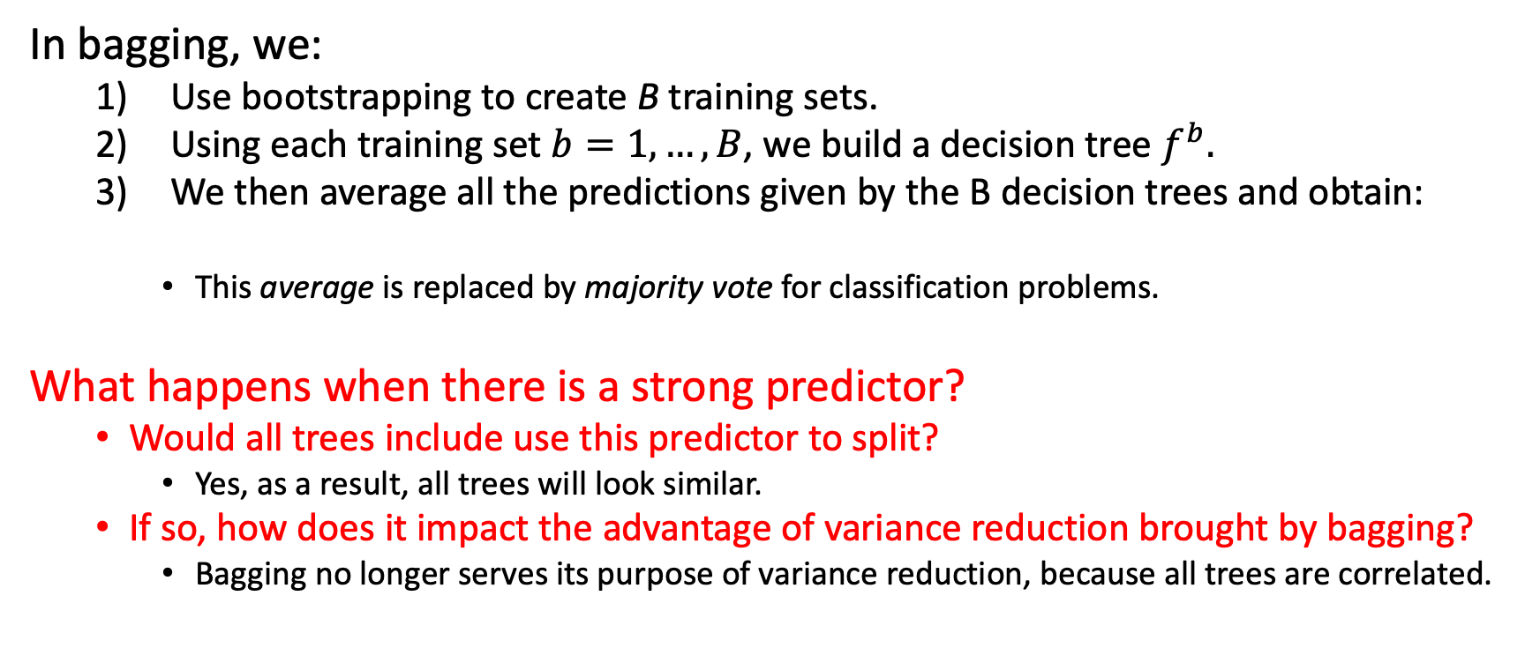
Summary of Bagging
In bagging, we:
Use bootstrapping to create B training sets.
Using each training set $b=1,…, B$, we build a decision tree $f^{b}.$
We then average all the predictions given by the B decision trees and obtain:
This average is replaced by majority vote for classification problems.
What happens when there is a strong predictor?
Would all trees include use this predictor to split?
Yes, as a result, all trees will look similar.
If so, how does it impact the advantage of variance reduction brought by bagging?
Bagging no longer serves its purpose of variance reduction, because all trees are correlated.

Slide 14
Agenda
Decision trees
Overview
Regression trees
Tree pruning
Classification trees
Tree-based methods
Bagging
Random Forest
Boosting

Slide 15
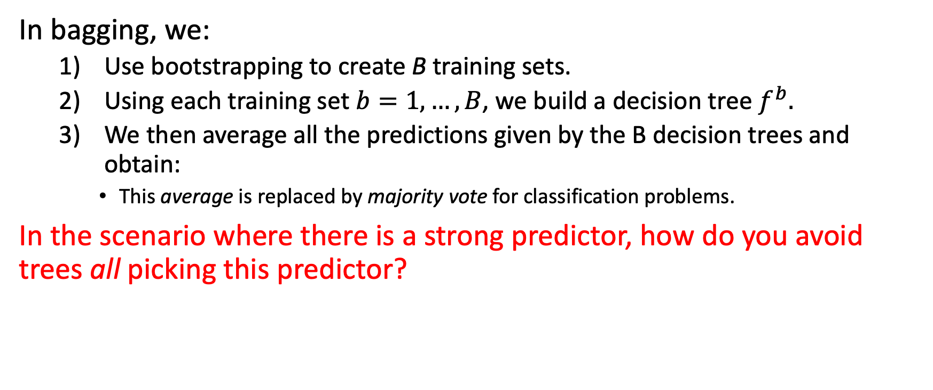
Random Forest
In bagging, we:
Use bootstrapping to create B training sets.
Using each training set $b=1,…, B$, we build a decision tree $f^{b}.$
We then average all the predictions given by the B decision trees and obtain:
This average is replaced by majority vote for classification problems.
In the scenario where there is a strong predictor, how do you avoid trees all picking this predictor?

Slide 16
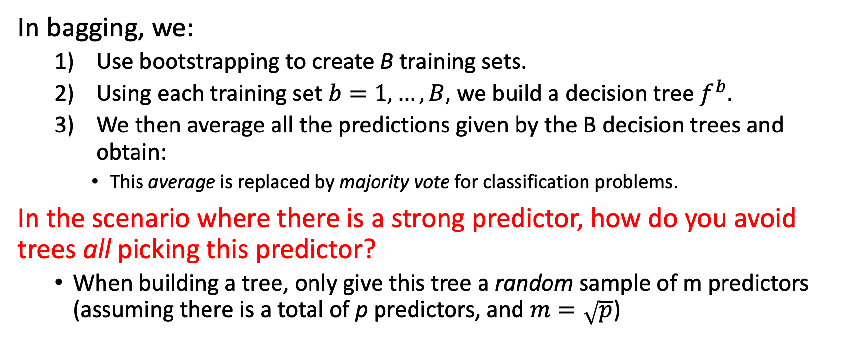
Random Forest
In bagging, we:
Use bootstrapping to create B training sets.
Using each training set $b=1,…, B$, we build a decision tree $f^{b}.$
We then average all the predictions given by the B decision trees and obtain:
This average is replaced by majority vote for classification problems.
In the scenario where there is a strong predictor, how do you avoid trees all picking this predictor?
When building a tree, only give this tree a random sample of m predictors (assuming there is a total of p predictors, and $m=\sqrt{p}$)

Slide 17
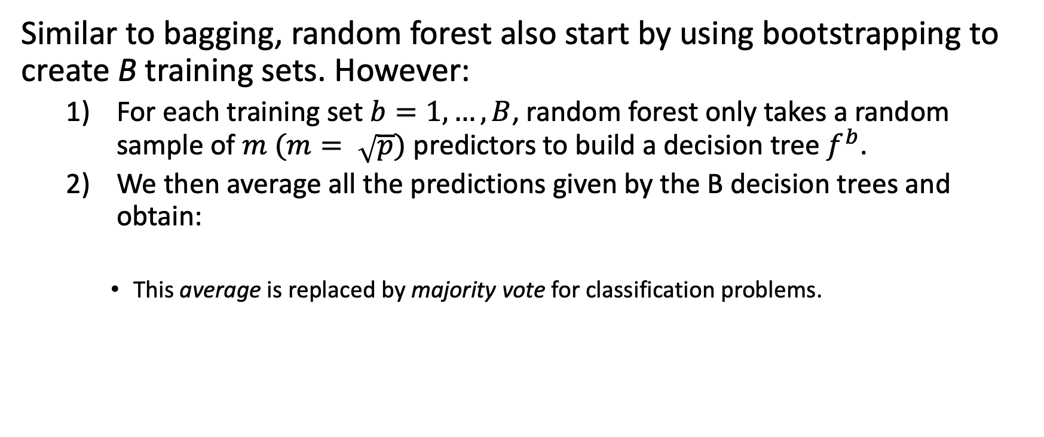
Random Forest
Similar to bagging, random forest also start by using bootstrapping to create B training sets. However:
For each training set $b=1,…, B$, random forest only takes a random sample of $m (m= \sqrt{p})$ predictors to build a decision tree $f^{b}$.
We then average all the predictions given by the B decision trees and obtain:
This average is replaced by majority vote for classification problems.

Slide 18
Agenda
Decision trees
Overview
Regression trees
Tree pruning
Classification trees
Tree-based methods
Bagging
Random Forest
Boosting

Slide 19
Boosting
Both bagging and random forest are building multiple trees, where each tree is a model with predictors X and response y.
Boosting, on the other hand, builds small trees where each tree is a model between predictors X and the residual r.

Slide 20
Boosting
Both bagging and random forest are building multiple trees, where each tree is a model with predictors X and response y.
Boosting, on the other hand, builds small trees where each tree is a model between predictors X and the residual r.
At step 1, the residual r = y. We build a tree with d splits (d = 1 usually works well enough).

Slide 21
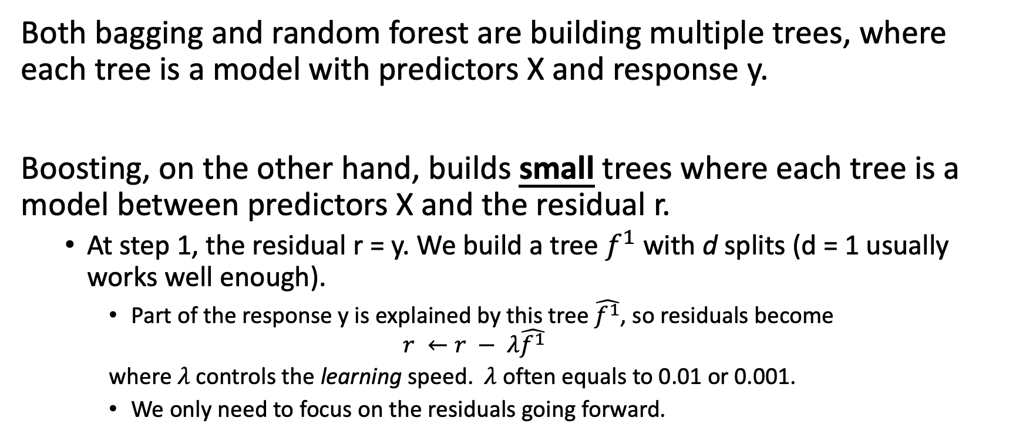
Boosting
Both bagging and random forest are building multiple trees, where each tree is a model with predictors X and response y.
Boosting, on the other hand, builds small trees where each tree is a model between predictors X and the residual r.
At step 1, the residual r = y. We build a tree $f^{1}$ with d splits (d = 1 usually works well enough).
Part of the response y is explained by this tree $\hat{f^{1}}$, so residuals become
$$r ←r − λ\hat{f^{1}}$$
where$λ$ controls the learning speed. $λ$ often equals to 0.01 or 0.001.
We only need to focus on the residuals going forward.

Slide 22
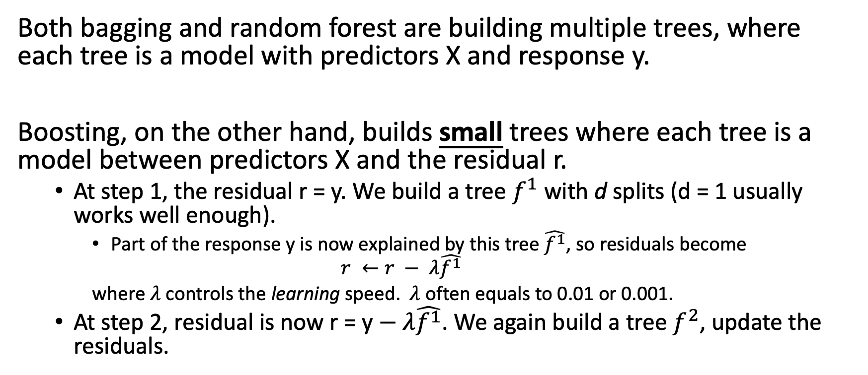
Boosting
Both bagging and random forest are building multiple trees, where each tree is a model with predictors X and response y.
Boosting, on the other hand, builds small trees where each tree is a model between predictors X and the residual r.
At step 1, the residual r = y. We build a tree $f^{1}$ with d splits (d = 1 usually works well enough).
Part of the response y is now explained by this tree $\hat{f^{1}}$, so residuals become
$$r ←r − λ\hat{f^{1}}$$
where$λ$ controls the learning speed. $λ$ often equals to 0.01 or 0.001.
At step 2, residual is now r = y$− λ\hat{f^{1}}$. We again build a tree $f^{2}$, update the residuals.

Slide 23
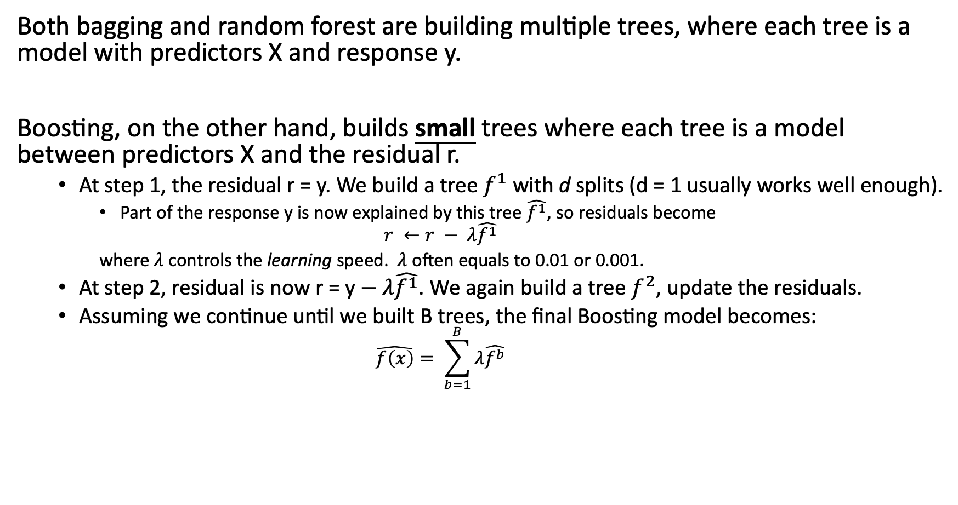
Boosting
Both bagging and random forest are building multiple trees, where each tree is a model with predictors X and response y.
Boosting, on the other hand, builds small trees where each tree is a model between predictors X and the residual r.
At step 1, the residual r = y. We build a tree $f^{1}$ with d splits (d = 1 usually works well enough).
Part of the response y is now explained by this tree $\hat{f^{1}}$, so residuals become
$$r ←r − λ\hat{f^{1}}$$
where$λ$ controls the learning speed. $λ$ often equals to 0.01 or 0.001.
At step 2, residual is now r = y$− λ\hat{f^{1}}$. We again build a tree $f^{2}$, update the residuals.
Assuming we continue until we built B trees, the final Boosting model becomes:
$$\hat{f\left(x\right)}= \sum_{b=1}^{B}{λ\hat{f^{b}}}$$

Slide 24
Agenda
Decision trees
Overview
Regression trees
Tree pruning
Classification trees
Tree-based methods
Bagging
Random Forest
Boosting

Slide 25
Summary of tree-based methods
Bagging: Obtain B bootstrapped datasets and build B trees independently. The final model is an average (majority vote) over all B trees.

Slide 26
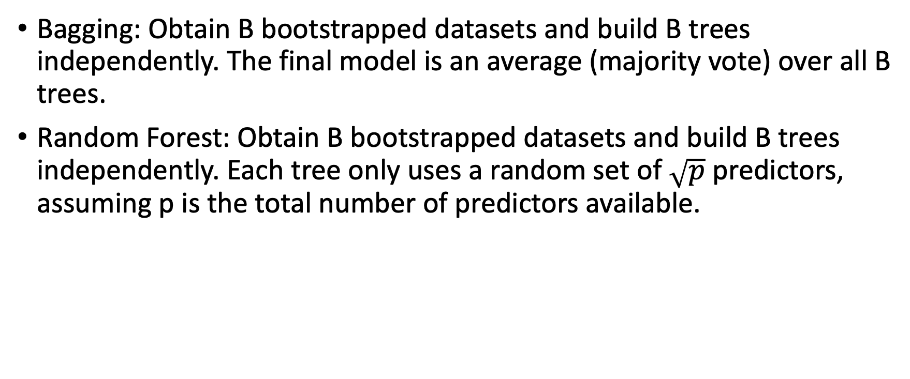
Summary of tree-based methods
Bagging: Obtain B bootstrapped datasets and build B trees independently. The final model is an average (majority vote) over all B trees.
Random Forest: Obtain B bootstrapped datasets and build B trees independently. Each tree only uses a random set of $\sqrt{p}$ predictors, assuming p is the total number of predictors available.

Slide 27
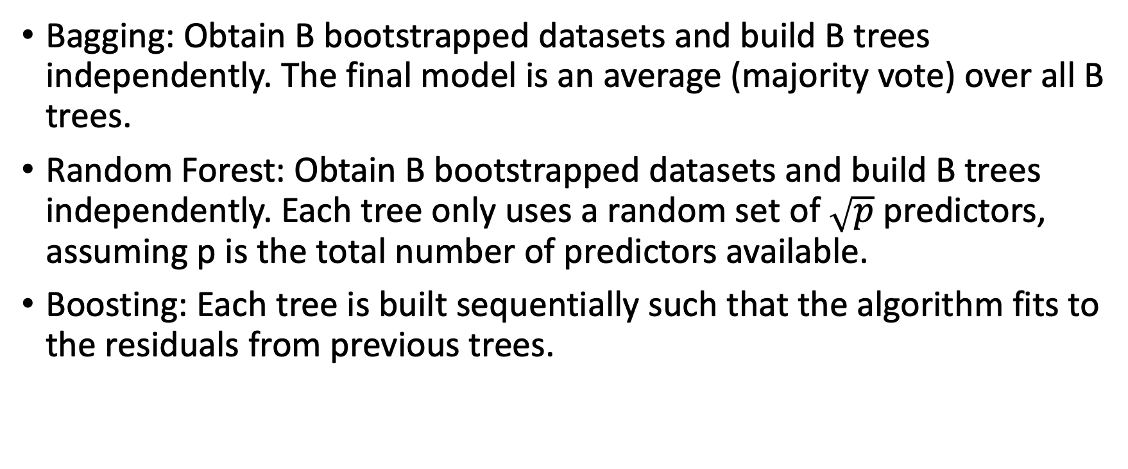
Summary of tree-based methods
Bagging: Obtain B bootstrapped datasets and build B trees independently. The final model is an average (majority vote) over all B trees.
Random Forest: Obtain B bootstrapped datasets and build B trees independently. Each tree only uses a random set of $\sqrt{p}$ predictors, assuming p is the total number of predictors available.
Boosting: Each tree is built sequentially such that the algorithm fits to the residuals from previous trees.

